Slide 1
Silver Oak College
Of
Computer Application

Slide 2
Name :- Shah Het K.
Sem :- 2.
Divison :- M1A3 & A
Subject Name :- DHTML
Project Name :- LIGHT|STUDIO
Project Guide :- Professor Shivam Sir Rajput

Slide 3
Welcome to Light Studio Shopping Website!
Our Products
Secure Checkout
Fast and Reliable Shipping
Customer Service
Start Shopping Today!

Slide 4
Welcome to Light Studio Shopping Website!
Light Studio Shopping Website is the ultimate destination for all your shopping needs.
We provide a wide selection of products from top brands to fit all your needs.
We offer a convenient and secure checkout process, as well as fast and reliable shipping.
With our easy-to-navigate website, you can find what you need quickly and easily.

Slide 5
Our Products
We offer a wide selection of products from top brands.
Whether you're looking for electronics, clothing, home goods, or anything else, we have it all.
Our products are of the highest quality and come with a satisfaction guarantee.
We also offer competitive prices and free shipping on orders over ₹199.

Slide 6
Secure Checkout
We provide a secure checkout process so you can shop with confidence.
Our website is encrypted to protect your personal information and credit card details.
We also offer a variety of payment options, including PayPal, credit card, and Apple Pay.
Our checkout process is quick and easy, so you can get your order fast

Slide 7
Fast and Reliable Shipping
We offer fast and reliable shipping on all orders. We ship to two states and most international destinations.
Most orders are shipped within 24 hours.
We also offer free shipping on orders over ₹199.
We use a variety of shipping carriers, so you can get your order when you need it.

Slide 8
Customer Service
Our customer service team is here to help.
We offer 24/7 support via phone, email, and live chat.
We also offer a satisfaction guarantee on all of our products.
If you have any questions or concerns, don't hesitate to contact us.
We're here to help you find the perfect product for your needs.

Slide 9
Start Shopping Today!
We invite you to start shopping today.
With our easy-to-navigate website, secure checkout process, and fast and reliable shipping, you can find what you need quickly and easily.
Thank you for choosing Light Studio Shopping Website.
We look forward to helping you find the perfect product for your needs.

Slide 10
GRAY LAYOUT

Slide 11
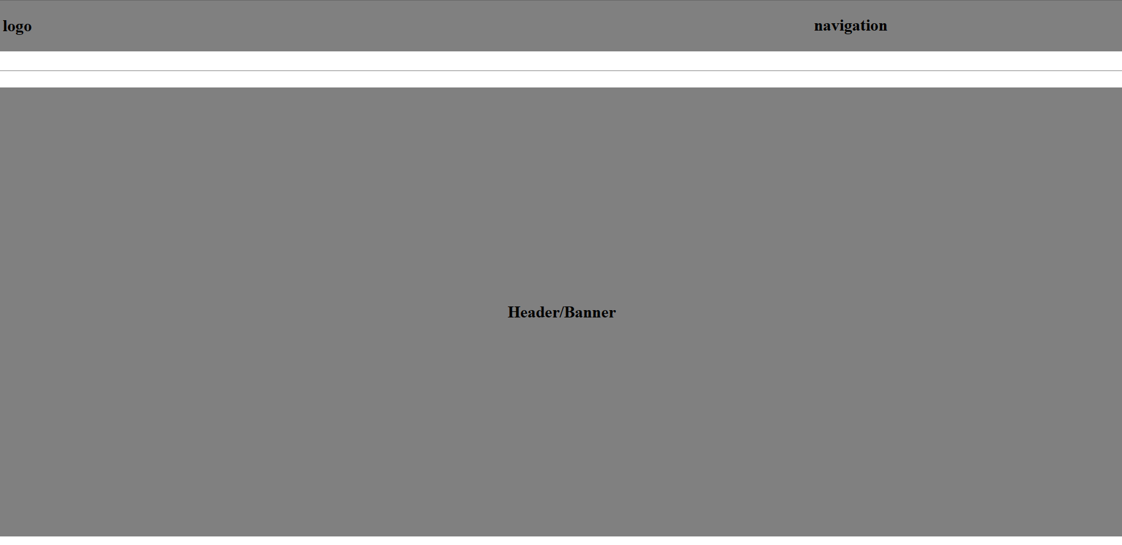

Slide 12


Slide 13
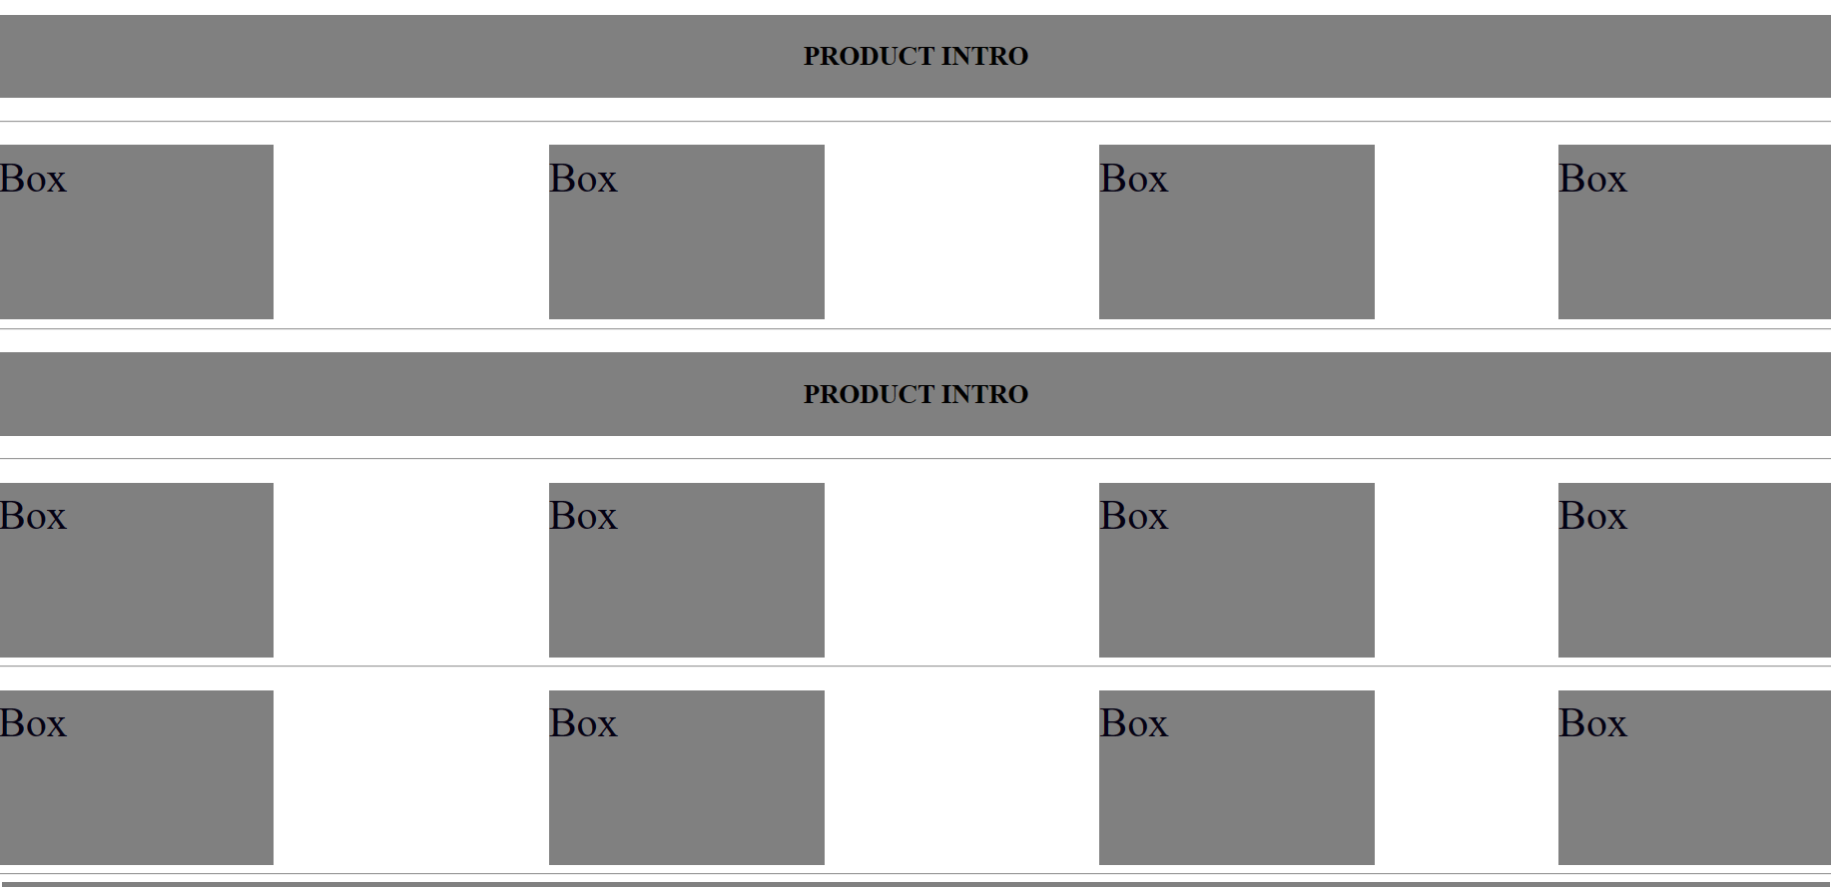

Slide 14


Slide 15
Difference Between Others and mine website

Slide 16
Light Studio Shopping Website Compair to Bewakoof
Light Studio is a shopping website that offers a wide selection of products ranging from apparel to electronics. It is easy to navigate and offers a great variety of products, making it a great choice for anyone looking to shop online. The website also has a comparison feature, allowing customers to compare prices and features of different items.This makes it easy to find the best deal for whatever you're looking for.
Bewakoof is another shopping website that offers a wide selection of products.It is also easy to navigate and offers a great variety of products.However, Bewakoof does not have a comparison feature like Light Studio does.This makes it difficult to compare prices and features of different items, making it harder to find the best deal for whatever you're looking for.

Slide 17
Light Studio Shopping Website Benefits
Light Studio offers a wide selection of products, making it easy to find what you're looking for.The website also has a comparison feature, allowing customers to compare prices and features of different items.
This makes it easy to find the best deal for whatever you're looking for.Additionally, the website is easy to navigate and has a great variety of products.
Light Studio also offers customer support and a secure payment system. This ensures that customers can shop with confidence, knowing that their information is safe and that they will be taken care of if they have any issues.
The website also has a rewards program, allowing customers to earn points for every purchase they make. These points can be used to get discounts on future purchases.

Slide 18
Light Studio Shopping Website Summary
Light Studio is a great choice for anyone looking to shop online.It offers a wide selection of products, making it easy to find what you're looking for.
The website also has a comparison feature, allowing customers to compare prices and features of different items.This makes it easy to find the best deal for whatever you're looking for.
Additionally, the website is easy to navigate and has a great variety of products.Light Studio also offers customer support and a secure payment system.
This ensures that customers can shop with confidence, knowing that their information is safe and that they will be taken care of if they have any issues.The website also has a rewards program, allowing customers to earn points for every purchase they make.
These points can be used to get discounts on future purchases.

Slide 19
Conclusion
Light Studio and Bekkuff are both great shopping websites that offer a wide selection of products.Light Studio has the added benefit of having a comparison feature, making it easier to find the best deal for whatever you're looking for.
Bekkuff does not have this feature, but it does offer customer support and a secure payment system.Both websites also have rewards programs, allowing customers to earn points for every purchase they make.
Ultimately, it is up to the customer to decide which website is best for them. Both websites offer a great selection of products and have features that make them appealing.It is important to consider the features of each website and what is important to you when making a decision.

Slide 20
The Benefits of Shopping at Light Studio
Shopping at Light Studio offers customers a range of benefits. Customers can enjoy a wide selection of products, all at competitive prices.
Light Studio also offers free shipping on orders over a certain amount, as well as discounts and promotions.
Additionally, their customer service team is available 24/7 to answer any questions or concerns customers may have.
Light Studio also offers an easy-to-navigate website with a secure checkout system.Customers can quickly find what they’re looking for and complete their purchase in just a few clicks.
The website also features a loyalty program, where customers can earn points and rewards for shopping with Light Studio.

Slide 21
The Purpose of Light Studio
The purpose of Light Studio is to provide customers with an easy and convenient way to shop online.
They want to make sure customers have access to a wide selection of products at competitive prices, as well as excellent customer service.
Additionally, they want to make sure their website is easy to use and secure, so customers can shop with confidence.
Light Studio also wants to create a loyal customer base.
To do this, they offer rewards and discounts to customers who shop with them regularly.
They also want to ensure that customers have a positive experience when shopping with them, so they can come back again and again.

Slide 22
Light Studio Shopping Website Benefits
Shopping at Light Studio offers customers a range of benefits.Customers can enjoy a wide selection of products, all at competitive prices.
Light Studio also offers free shipping on orders over a certain amount, as well as discounts and promotions. Additionally, their customer service team is available 24/7 to answer any questions or concerns customers may have.
Light Studio also offers an easy-to-navigate website with a secure checkout system.Customers can quickly find what they’re looking for and complete their purchase in just a few clicks.
The website also features a loyalty program, where customers can earn points and rewards for shopping with Light Studio.

Slide 23
Light Studio’s Customer Service
Light Studio’s customer service team is available 24/7 to answer any questions or concerns customers may have.
They strive to provide fast and helpful responses to all inquiries, so customers can get the help they need quickly and easily.
Additionally, they offer a variety of payment options, so customers can choose the one that works best for them.
Light Studio also offers a satisfaction guarantee.
If customers are not satisfied with their purchase, they can return it for a full refund.
This allows customers to shop with confidence, knowing that their purchase is protected.

Slide 24
QUESTION ANSWER
What is Light Studio?
Light Studio is an e-commerce website that specializes in selling products such as t-shirts, shoes, watches and glasses.
What types of products are available at Light Studio?
Light Studio offers a variety of products including t-shirts, shoes, shirts, glasses and watches.
Is it safe to shop on Light Studio's website?
Yes, Light Studio's website is secure and uses SSL encryption to protect your personal and financial information.
Does Light Studio offer free shipping?
Yes, Light Studio offers free shipping on orders over a certain amount, depending on the customer's location.
What is Light Studio's return policy?
Light Studio offers a 45-day return policy for most items, as long as they are in their original condition and packaging. However, some items may be subject to a restocking fee. Customers should review Light Studio's return policy before purchasing

Slide 25
THANK YOU

